Slide 1
Ultrafast FPGA Prototyping Flow

Slide 2
Outline
FPGA structure
LUT, RAMB, DSP, IO, CLOCK
Prototyping flow
Synplify synthesis
Vivado implement
Polestar verification plan
Hardware structure
System-level verify tasks

Slide 3
FPGA Structure

Slide 4
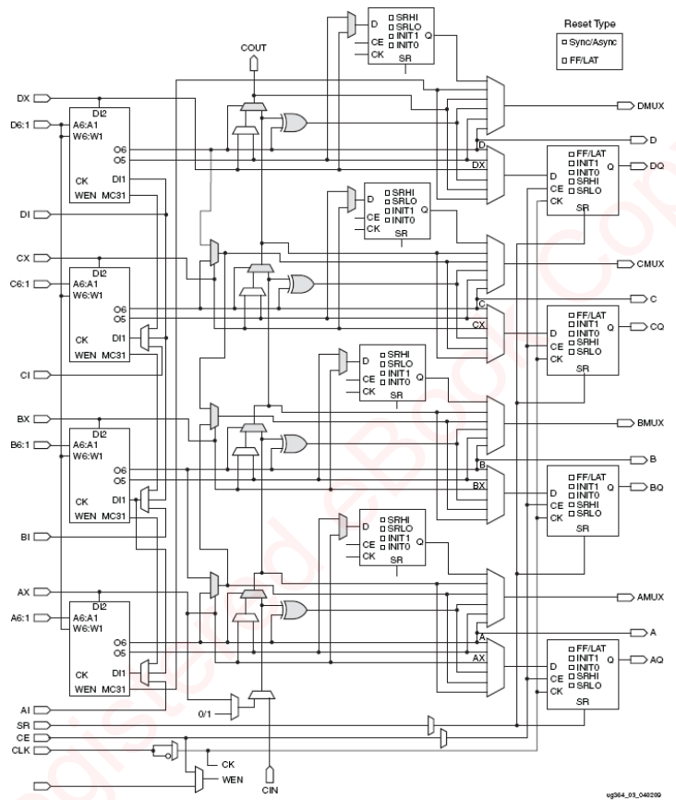
FPGA structure -- logic blocks
6-input LUT is actually a 64x1 RAM
Flip-flop consists of 5 NAND gates
A SLICEM contains 4 LUT6, 8 FFs and cascading logic
Implement combinatorial functions, small RAM or shift register
A SLICEL contains 4 LUT6
Implement combinatorial logic
Two slices combined into a CLB
The basic logic cells in FPGA array

Slide 5
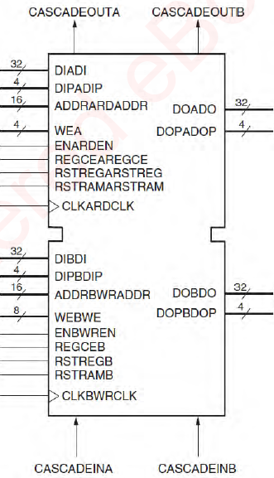
FPGA structure -- memories
Distributed RAM
Small memories instantiated by SLICEM
Block RAM
Configurability: dedicated, dual-ported synchronous 36Kbits RAM can be configured for different width and depth
Synchronous of each port for different clock rate
FIFO logic

Slide 6
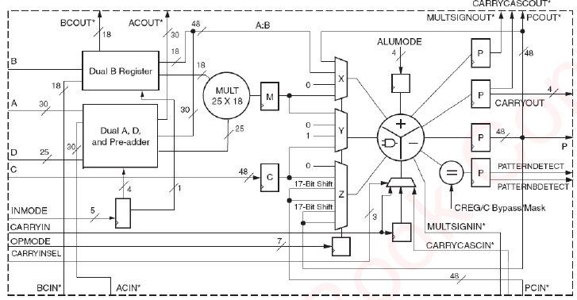
FPGA structure -- DSP slice
DSP48E1: dedicated, configurable and low-power
25x18 bit multiplier
48-bit accumulator
30x25 bit pre-adder
Map objects in many modes
wide dynamic bus shifter
memory address generator
wide bus multiplexer

Slide 7
FPGA structure -- Clock network
MMCM is a configurable clock generation unit
Clock distribution resources
Global clocks, high fan-out, low distribution delay, can be driven by global clock buffer and MMCM output
Reginal clocks (a region is defined as any area that is 40 IOs and 40 CLBs)
IO clocks, serve only IO logic and SERDES circuits

Slide 8
FPGA structure -- IO pins
40 pins consist of one bank which has a common Vcc
Single-ended IO uses CMOS push/pull output structure and can be put into high-Z state
Can be configured as either combinatorial or registered
IO delay (0 ~ 78ps) and drive current ( 2mA ~ 24mA)
Differential IO with LVDS standards supported

Slide 9
Prototyping Flow

Slide 10
Prototyping Intro
benefit
limitation
High performance and accuracy
Real-time/long-time dataflow within the real world
Hardware-software integration
Out-of-lab demonstration
Not a simulator or debugger
Iteration cycle is long
ASIC is larger than FPGA
ASIC is faster than FPGA
Analog PHY shall be removed

Slide 11
Prototyping Flow
RTL modification
Manual partition for multi-FPGAs (optional)
Synthesis sub-modules with Synplify
Add constraint for PAD, clock, IO
Place&Route with Vivado
Debug and ECO

Slide 12
RTL Modifications
Top-level wrapper (pin share, PAD, PLL)
TSMC gate-level netlists
SOC memories, DesignWare
Build-in self test (BIST) is not required
Gated clocks
Complex generated clocks

Slide 13
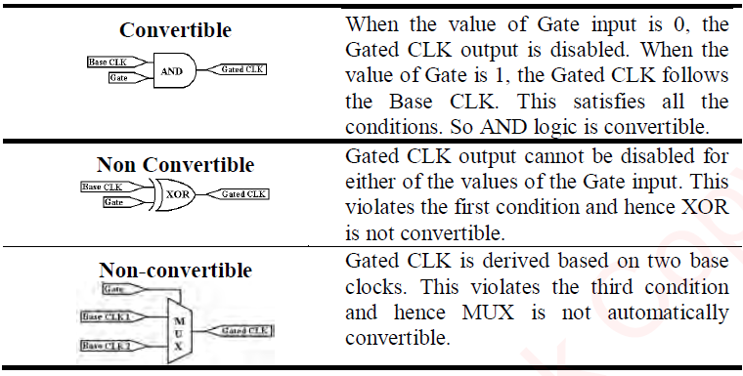
RTL Modifications -- Gate Clock Conversion
Identify the base clocks in SDC
Insert black-box for combinational loop
For non convertible clock
Manually add clock buffers, PLLs for balancing
Use high frequency global clock to detect gated clock edge as new clock enable
Directly assign output clock to input clock with gate logic bypassed

Slide 14


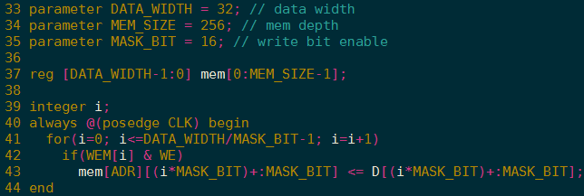
RTL Modifications -- Block RAMs
MASK_BIT | Block RAM utilization
1
4
8
32

Slide 15
RTL Modifications -- Top/Partition Wrapper
FPGA TOP Wrapper
Instantiate PLL and clock buffers, DDR3/DDR4 , ROM and inout IO connection
Instantiate Black-Box for sub-modules
Instantiate SOC_TOP without analog PHY
Partition Wrapper
Standalone, large size, low performance IPs
CEVA, HEVC
Need pin mux logic for insufficient IOs between FPGAs
Workaround to avoid partition
Several special version for different data path

Slide 16
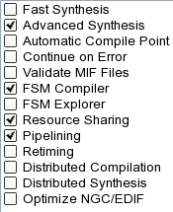
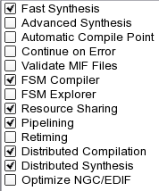
Bottom-up Synthesis -- Synplify Premier
Netlist generation
Generate netlist for sub-modules, parallel synthesis can be finished in a day
Generate netlist for TOP wrapper
Only correlative module and TOP wrapper need to resynthesize when there are modifications
Time: 10m:41s
Freq. 123.9MHz
Time: 2m:33s
Freq. 50MHz

Slide 17
Implementation -- Vivado P&R
Project tcl based flow: check DRC report at each stage
Link design: link all netlist from synplify
Opt design: optimized with netlist
Incremental check point read out (optional)
Less than 5% modifications can save half implementation time
Place design
Route design
Timing constrain is very important
Clock groups / Cross clock domain
False path / multi-cycle path
Input / output delay
DON’T over constrain; DON’T floorplan

Slide 18
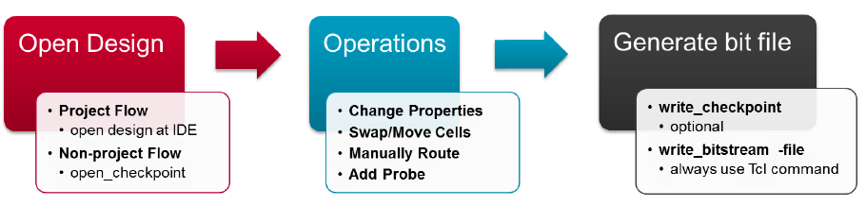
Implementation -- Vivado ECO
Applications
Change properties of LUTs (default value of Register; clock phase of MMCM)
“UpdateMEM” can update bit files with MMI and ELF data
Swap/move cells, disconnect/re-route nets
Replace/add debug probes
ECO can be finished within about 1 hour

Slide 19
Real-time Debug -- ILA/JTAG
With Vivado logic analyzer
Capture probe waveform
Set kinds of trigger condition
With JTAG interface
Read out all registers and memories

Slide 20
Polestar Prototype Plan

Slide 21
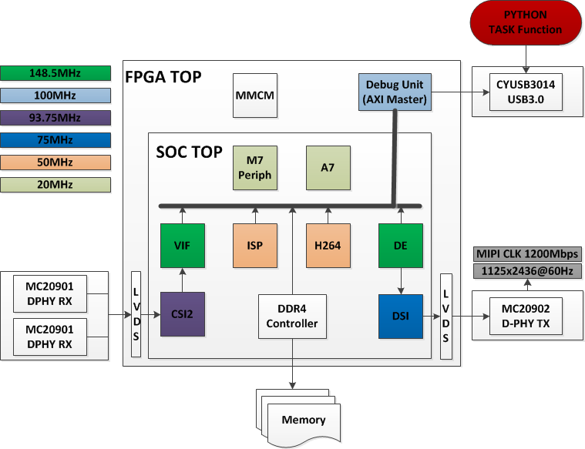
Hardware Structure

Slide 22
Software tasks
No. | Description | Status
CSI2 #1 | Different data lanes: MIPI 1, 2, 4lane
CSI2 #2 | Different sensor numbers: Senor 1, 2, 4, 8
CSI2 #3 | Different virtual channel: VC0, 1, 2, 3 and combination
CSI2 #4 | Different data type: RAW8, RAW10, RAW12, RGB
VIF | Different image resolution: VGA, 720P, 1080P, 4K2K
H264 | Encode and decode for different resolution
ISP | Reserved
DSI #1 | MIPI 1, 2, 4 lane
DSI #2 | Resolution: 720P, 1080P
DSI #3 | Video mode, Command mode

Slide 23
System evaluation
Hardware
About 60% LUT, 80% DSP, 70% RAMB resources of VU440FLGA2892
3 daughter boards need PCB produce
2 VU440 platforms (already exists)
Software
Python 3.6 with USB control
Time estimate
First prototype needs about 2 weeks
Compile once a day
ECO 3 times a day
Traversal verification tasks several times a day

Slide 24
Thank you

